Slide 1

SOFTWARE QUALITY ENGINEERING
BS Software Engineering
Semester, Fall 2025
Credit Hours 2-1
Instructor: Naseer Jan
Department of Creative Technologies
Air University
Islamabad, Pakistan

Slide 2
Agenda
Week 1 Review
Subtopics

Slide 3
Software Quality Assurance
QA as Dealing with Defect
Quality Assurance (QA) activities attempt to prevent, eliminate, reduce, or contain various specific problems associated with different aspects of defects. We can classify these QA alternatives into the following three generic categories:
Defect prevention through error blocking or error source removal
Defect reduction through fault detection and removal
Defect containment through failure prevention and containment

Slide 4
QA as Dealing with Defect
Defect prevention through error blocking or error source removal
These QA activities prevent certain types of faults from being injected into the software. Since errors are the missing or incorrect human actions that lead to the injection of faults into software systems, we can directly correct or block these actions, or remove the underlying causes for them.
defect prevention can be done in two generic ways:
- Eliminating certain error sources: eliminating ambiguities or correcting human misconceptions, which are the root causes for the errors.
- Fault prevention or blocking: by directly correcting or blocking these missing or incorrect human actions. This group of techniques breaks the causal relation between error sources and faults through the use of certain tools and technologies, enforcement of certain process and product standards, etc.

Slide 5
QA as Dealing with Defect
Defect reduction through fault detection and removal
These QA alternatives detect and remove certain faults once they have been injected into the software systems. In fact, most traditional QA activities fall into this category. For example,
- Inspection directly detects and removes faults from the software code, design.
- Testing removes faults based on related failure observations during program execution.
Various other means, based on either static analyses or observations of dynamic executions, can be applied to reduce the number of faults in a software system
Defect containment through failure prevention and containment

Slide 6
QA as Dealing with Defect
Defect containment through failure prevention and containment:
These containment measures focus on the failures by either containing them to local areas so that there are no global failures observable to users, or limiting the damage caused by software system failures. Therefore, defect containment can be done in two generic ways:
Some QA alternatives, such as the use of fault-tolerance techniques, break the causal relation between faults and failures so that local faults will not cause global failures, thus “tolerating” these local faults.
A related extension to fault-tolerance is containment measures to avoid catastrophic consequences, such as death, personal injury, and severe property or environmental damages, in case of failures.
For example, failure containment for real-time control software used in nuclear reactors may include concrete walls to encircle and contain radioactive material in case of reactor melt-down due to software failures, in order to prevent damage to environment and people’s health.

Slide 7

Dealing with pre/post release defects
Different QA alternatives : errors, faults, or failures, in order to achieve the common goal of quality assurance and improvement.
Defect prevention and defect reduction activities directly deal with the competing processes of defect injection and removal during the software development process.
They affect the defect contents, or the number of faults, in the finished software products by working to reduce the pre-release defect injections or to remove as many such defects as possible before product release.
The faults left in the finished software products are often called “dormant defects”, which may stay dormant for some time, but have the potential of causing problems to customers and users of the products-a situation that we would like to alleviate or avoid.
Further analyses of different types of defects can be found in Chapter 20.
Related techniques to identify high-risk areas for focused defect reduction and QA can be found in Chapter 21.

Slide 8
Dealing with pre/post release defects
After product release, the failures observed and problems reported by customers and users also need to be fixed.
However, one cannot rely on these post-release problem reports and give up pre-release defect prevention and reduction activities, because the cost of fixing defects after product release is significantly higher than before product release due to the numerous installations.
In addition, the damage to software vendors’ reputation can be devastating.
Controlled field testing, commonly referred to as “beta testing”, and similar techniques discussed further in Chapter 12 have been suggested and used to complement pre-release QA activities.
Related process issues are discussed in Chapter 4.

Slide 9
Dealing with pre/post release defects
defect containment activities aim at minimizing the negative impact of these remaining faults during operational use after product release. However, most of the defect containment techniques involve redundancies or duplications, and require significantly more development effort to design and implement related features.
Therefore, they are typically limited to the situations where in-field failures are associated with substantial damage, such as in corporate-wide database for critical data, global telecommunication networks, and various computer-controlled safety critical systems such as medical devices and nuclear reactors.
The details about these issues can be found in Chapter 16.

Slide 10
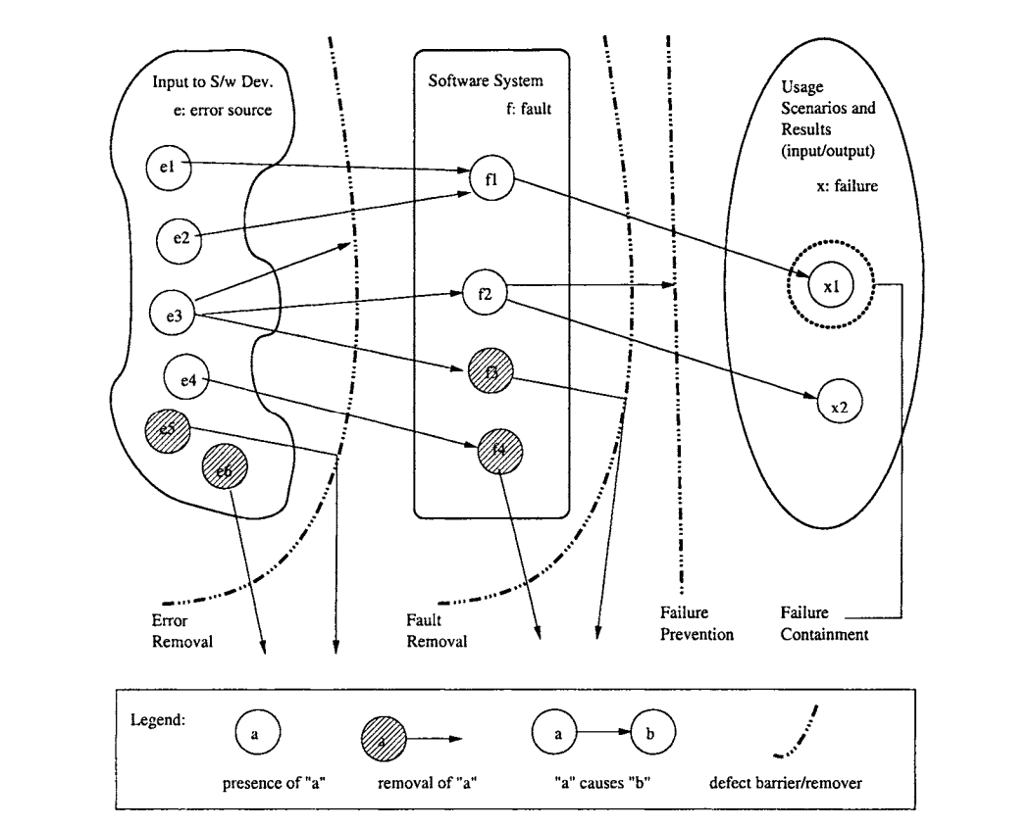
Graphical depiction of the classification scheme
The barrier between the input to software development activities (left box) and the software system (middle box) represents defect prevention activities
The curved barrier between the software system (middle box) and the usage scenario and observed behavior (right box) represents defect or fault removal activities such as inspection and testing.
The straight barrier to the right of and close to the above fault removal barrier represents failure prevention activities such as fault tolerance.
The last barrier, surrounding selected failure instances, represents failure containment activities.

Slide 11
Software Quality Engineering Assignment
Assignment shall address:
What does quality in Software Development mean to you?
What does quality in Software Products mean to you?
What does quality in Software Processes mean to you?
What benefits and shortcomings do we get from caring about quality in Software?
Discuss and motivate your answers.

Slide 12
Software Quality Engineering Assignment
Assignment shall address:
What does quality in Software Development mean to you?
What does quality in Software Products mean to you?
What does quality in Software Processes mean to you?
What benefits and shortcomings do we get from caring about quality in Software?
Discuss and motivate your answers.

Slide 13
Questions
Questions and Answers sessions

Slide 14


